Slide 1

7th Grade Math
Unit 8, Lesson 5 Evaluating Numeric Expressions – Part 2 Volume 2, pg. 27

Slide 2


Benchmarks
MA.7.NSO.2.1
Solve mathematical problems using multi step order of operations with rational numbers including grouping symbols, whole-number exponents, and absolute value.
MA.7.NSO.2.2
Add, subtract, multiply and divide rational numbers with procedural fluency.
volume 2, pg. 27

Slide 3
Integrated Mathematical Thinking and Reasoning Standards
MA.K12.MTR.1.1 Actively participate in effortful learning both individually and collectively.
MA.K12.MTR.2.1 Demonstrate understanding by representing problems in multiple ways.
MA.K12.MTR.3.1 Complete tasks with mathematical fluency.
MA.K12.MTR.4.1 Engage in discussions that reflect on the mathematical thinking of self and others.
MA.K12.MTR.5.1 Use patterns and structure to help understand and connect mathematical concepts.
volume 2, pg. 27

Slide 4

Learning Target
I can evaluate numeric expressions with up to three or four operations.
volume 2, pg. 27

Slide 5

Warm-Up
volume 2, pg. 28

Slide 6
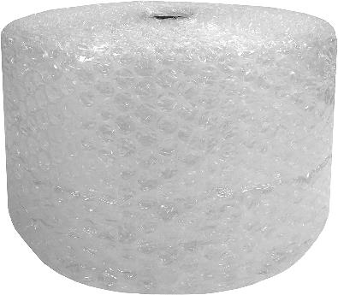


8.5.1 Warm-Up: Estimating Length
The roll of bubble wrap on the left is $1$ foot high and $100$ feet long.
Complete the following to guess the length of the bubble wrap on the right.
What is a guess that is too low?
Give a guess that does not make sense and explain how you know it doesn’t make sense.
volume 2, pg. 28

Slide 7
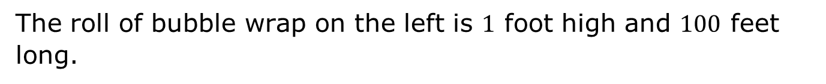
The roll of bubble wrap on the left is $1$ foot high and $100$ feet long.
What is a guess that is too high?
What is your best guess of the length of the bubble wrap on the right when unrolled?
volume 2, pg. 28

Slide 8

Guided Instruction
volume 2, pg. 28

Slide 9
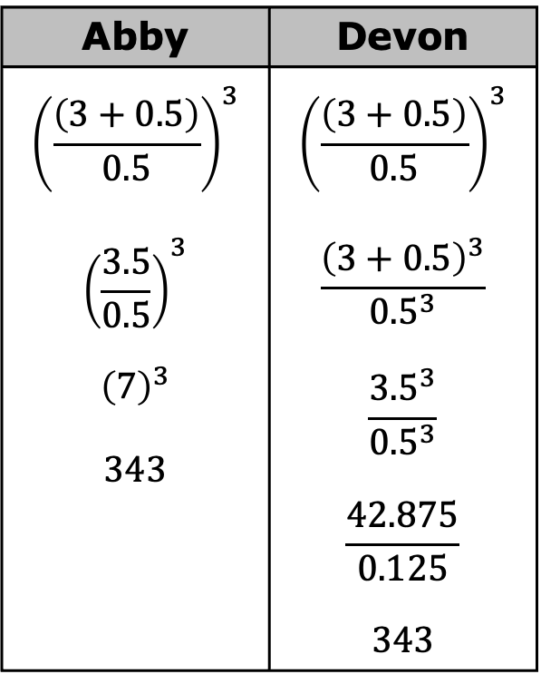

8.5.2 Guided Instruction: Using the Order of Operations on Expressions with Nested Grouping Symbols
The order of operations can be used to evaluate expressions using grouping symbols, rational numbers, exponents, and absolute values.
Two students evaluated the expression ${\left(\frac{\left(3+0.5\right)}{0.5}\right)}^{3}$. This expression shows nested grouping symbols, or groupings inside of other groupings.
How were Abby’s steps and Devon’s steps different from each other?
Abby | Devon
$${\left(\frac{\left(3+0.5\right)}{0.5}\right)}^{3}$$ $${\left(\frac{3.5}{0.5}\right)}^{3}$$ $${\left(7\right)}^{3}$$ $$343$$ | $${\left(\frac{\left(3+0.5\right)}{0.5}\right)}^{3}$$ $$\frac{{\left(3+0.5\right)}^{3}}{{0.5}^{3}}$$ $$\frac{{3.5}^{3}}{{0.5}^{3}}$$ $$\frac{42.875}{0.125}$$ $$343$$
volume 2, pg. 28

Slide 10

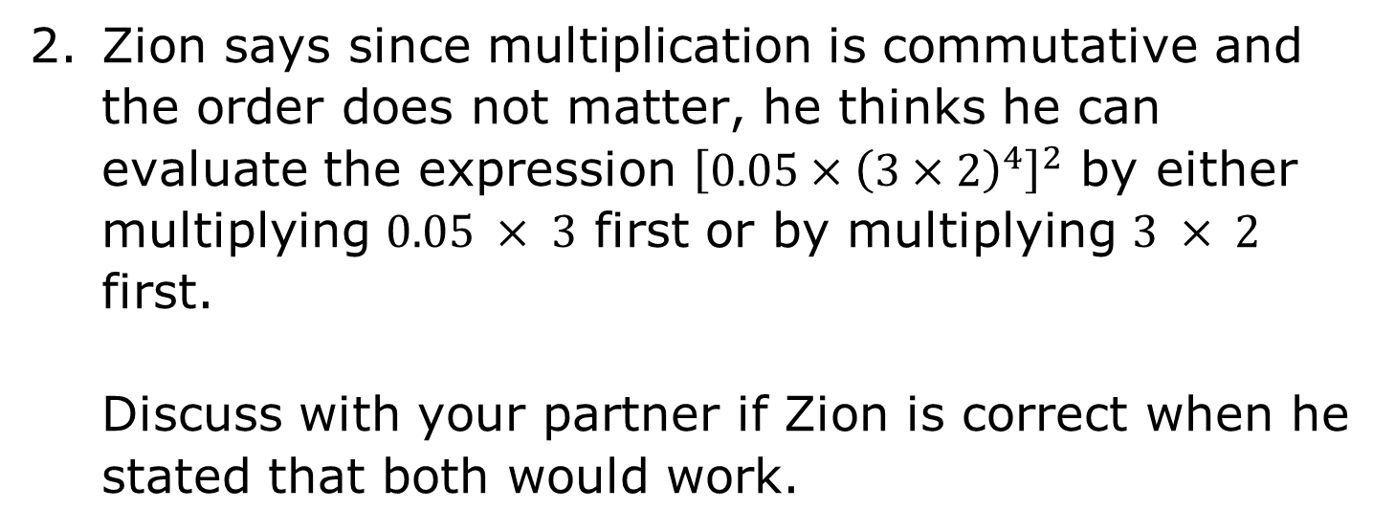
When using the order of operations to evaluate an expression with nested grouping symbols, apply the order of operations inside the inner grouping symbols first.
Zion says since multiplication is commutative and the order does not matter, he thinks he can evaluate the expression ${\left[0.05×{\left(3×2\right)}^{4}\right]}^{2}$ by either multiplying $0.05 × 3$ first or by multiplying $3 × 2$ first.
Discuss with your partner if Zion is correct when he stated that both would work.
volume 2, pg. 29

Slide 11
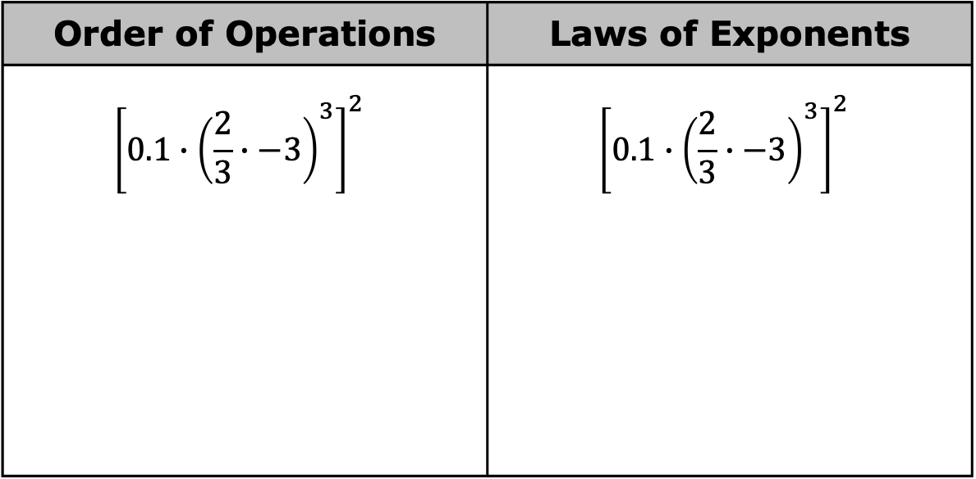
Telena says the problem can be worked either by following the order of operations or by using the laws of exponents. Complete the table to show the work for both possibilities to determine if Telena is correct.
Order of Operations | Laws of Exponents
$${\left[0.1∙{\left(\frac{2}{3}∙−3\right)}^{3}\right]}^{2}$$ | $${\left[0.1∙{\left(\frac{2}{3}∙−3\right)}^{3}\right]}^{2}$$
volume 2, pg. 29

Slide 12

Exploration
volume 2, pg. 29

Slide 13

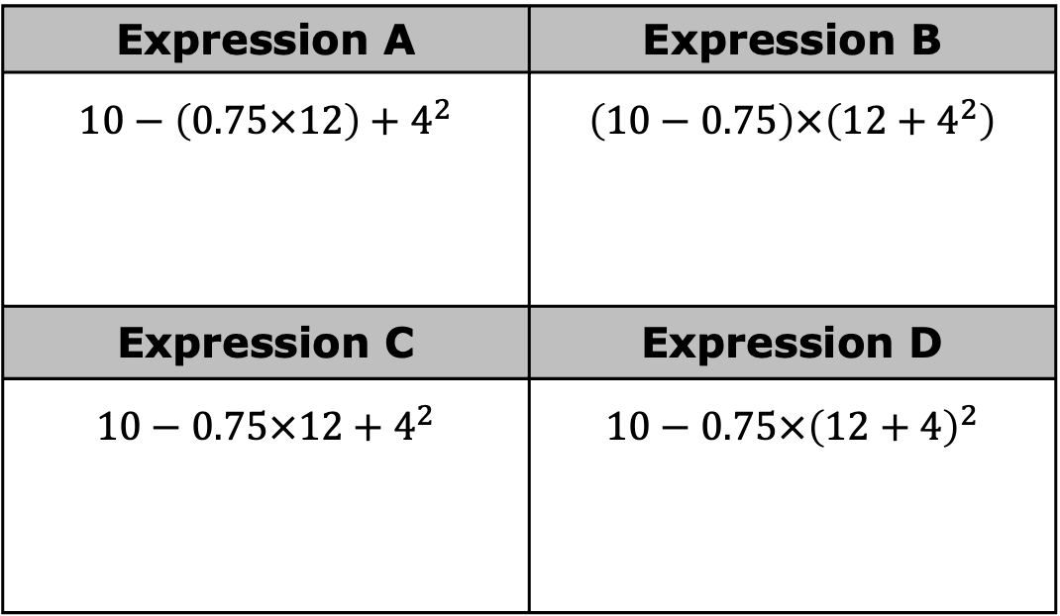
8.5.3 Exploration: Grouping Symbols
Without working the problems, discuss with your partner which expression in the table you expect to have the largest value.
Expression A | Expression B
$$10−\left(0.75×12\right)+4^{2}$$ | $$\left(10−0.75\right)×\left(12+4^{2}\right)$$
Expression C | Expression D
$$10−0.75×12+4^{2}$$ | $$10−0.75×{\left(12+4\right)}^{2}$$
volume 2, pg. 29

Slide 14
Put an asterisk (*) next to the expression you expect will have the largest value. Write your explanation here.
Evaluate each of the expressions in the table with your partner.
With another set of partners, share if your guess was or was not correct. Discuss how the order of operations affected the value of your guesses. Summarize your discussion.
For the two expressions in the table that resulted in the same value, explain why they have the same value.
volume 2, pg. 29

Slide 15

Collaboration
volume 2, pg. 30

Slide 16

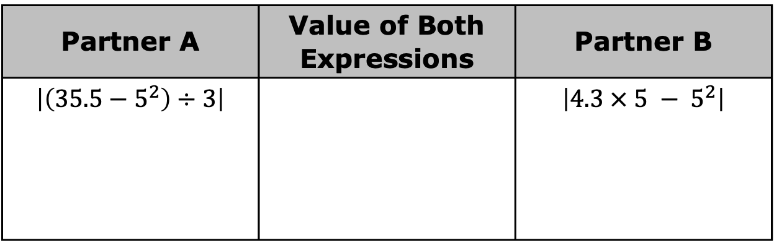
8.5.4 Collaboration: Using the Order of Operations to Evaluate Expressions with Nested Grouping Symbols
The expressions in each row have the same value. Evaluate the expressions in one column while your partner evaluates the expressions in the other column. Compare values and if they are not equivalent, work together to find and correct the error(s).
Partner A | Value of Both Expressions | Partner B
$$\left|\left(35.5−5^{2}\right)÷3\right|$$ |  | $$\left|4.3 × 5 − 5^{2}\right|$$
volume 2, pg. 30

Slide 17
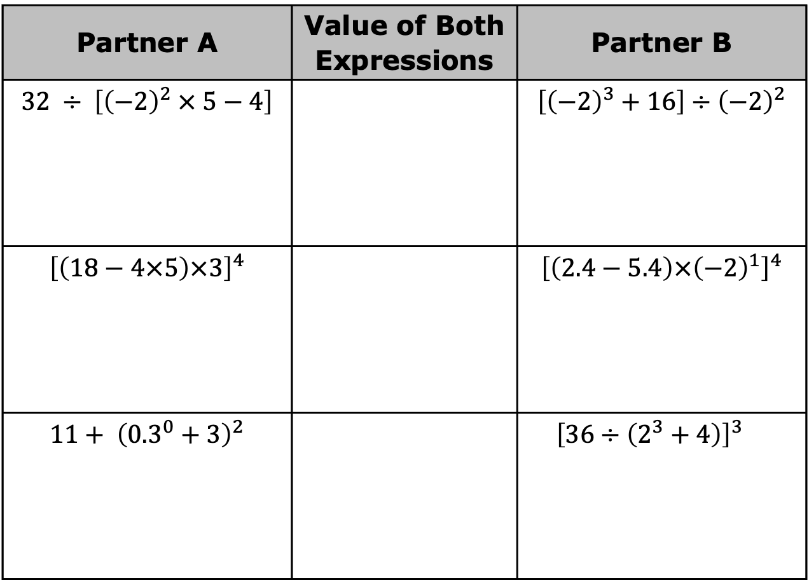
Partner A | Value of Both Expressions | Partner B
$$32 ÷ \left[{\left(−2\right)}^{2} × 5−4\right]$$ |  | $$\left[{\left(−2\right)}^{3}+16\right]÷{\left(−2\right)}^{2}$$
$${\left[\left(18−4×5\right)×3\right]}^{4}$$ |  | $${\left[\left(2.4−5.4\right)×{\left(−2\right)}^{1}\right]}^{4}$$
$$11+ {\left({0.3}^{0}+3\right)}^{2}$$ |  | $${\left[36÷\left(2^{3}+4\right)\right]}^{3}$$
volume 2, pg. 30

Slide 18


Your Turn
volume 2, pg. 31

Slide 19
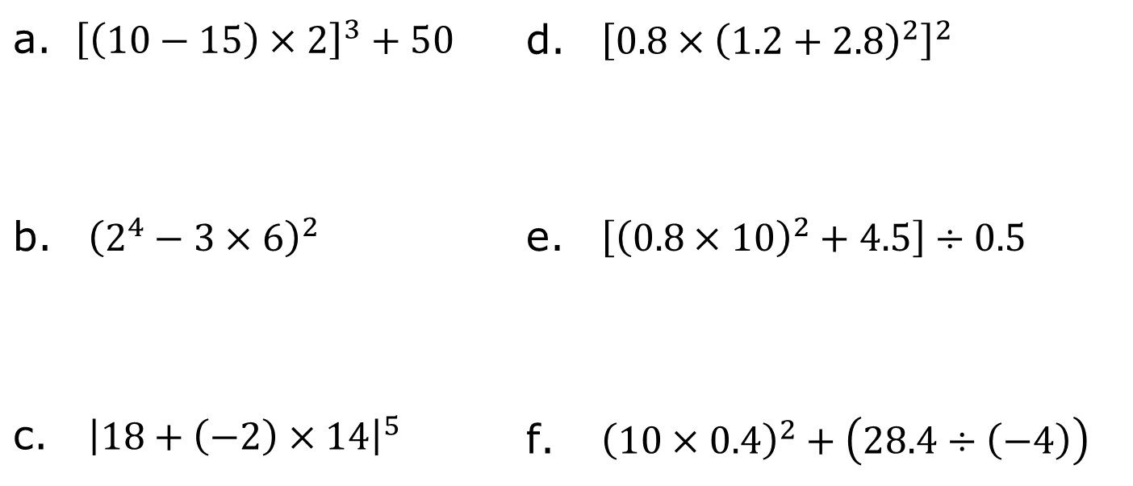
8.5.5 Your Turn!
Evaluate each expression without using a calculator.
${\left[\left(10−15\right)×2\right]}^{3}+50$ | ${\left[{0.8×\left(1.2+2.8\right)}^{2}\right]}^{2}$
${\left(2^{4}−3×6\right)}^{2}$ | $\left[{\left(0.8×10\right)}^{2}+4.5\right]÷0.5$
${\left|18+\left(−2\right)×14\right|}^{5}$ | ${\left(10×0.4\right)}^{2}+\left(28.4÷\left(−4\right)\right)$
volume 2, pg. 31

Slide 20

Wrap-Up
volume 2, pg. 31

Slide 21
8.5.6 Wrap-Up: Reflection
Complete each statement based on your learning today.
A barrier to my learning was …
I will try to overcome this by …
Today I am still unsure about …
To fill in this gap I intend to …
volume 2, pg. 31

